Slide 1
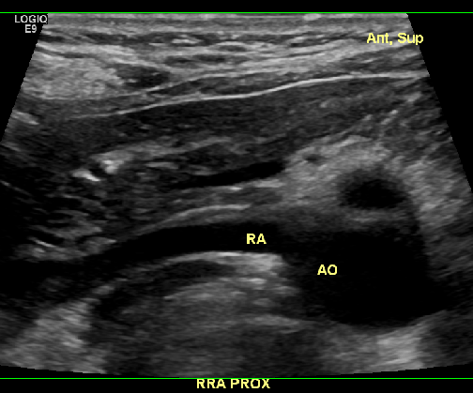
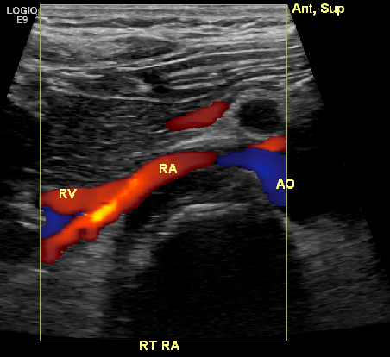
Normal Renal artery (Karl Nathaniel MRN E196854) Anterior (Peds pt)

Slide 2
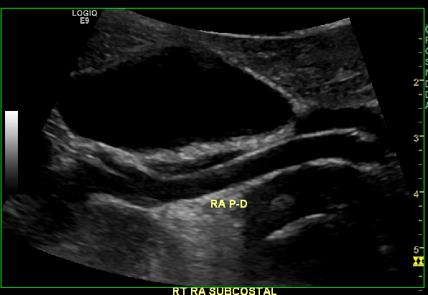
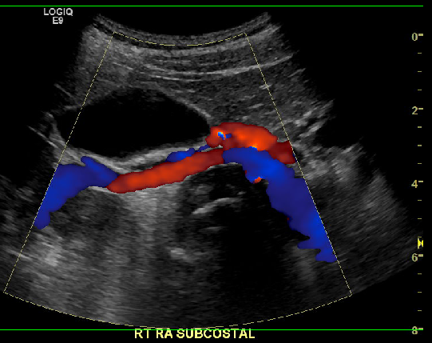
Normal Renal artery (Karl Nathaniel MRN E196854) Subcostal (Peds pt)

Slide 3
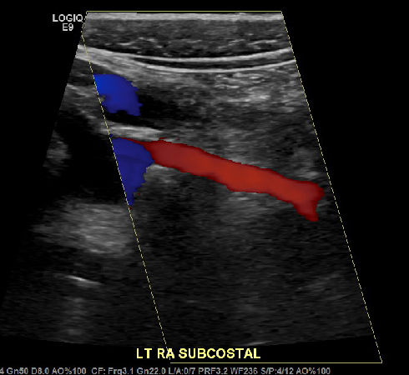
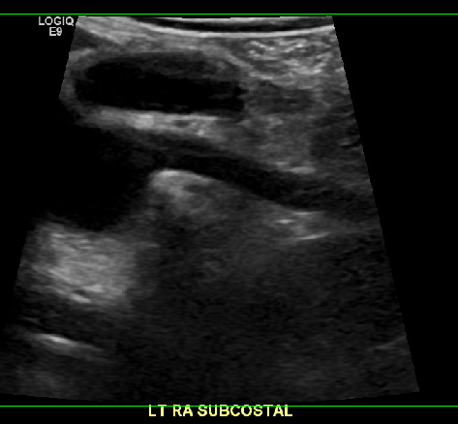
Normal Renal artery (Karl Nathaniel MRN E196854) Subcostal

Slide 4
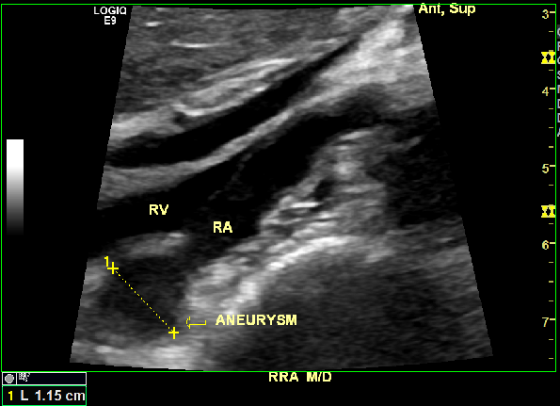
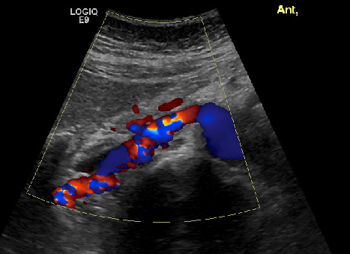
FMD w/ aneurysm Alison Gabbamonte (MRN 3993736)

Slide 5
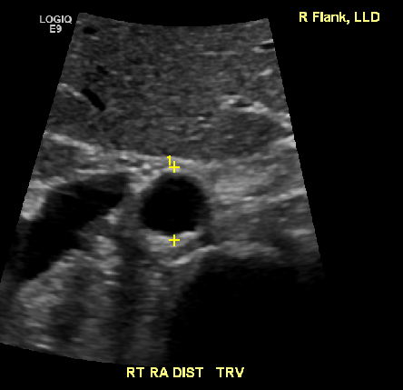
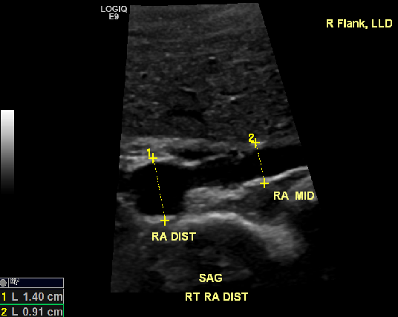
FMD w/ aneurysm Alison Gabbamonte (MRN 3993736)

Slide 6
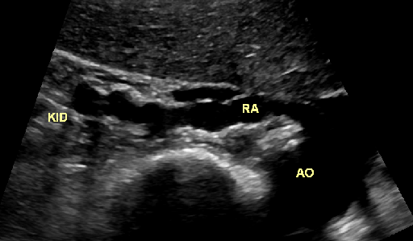
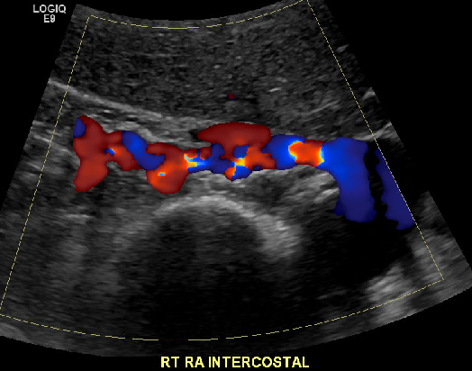
FMD w/ aneurysm Alison Gabbamonte (MRN 3993736)

Slide 7
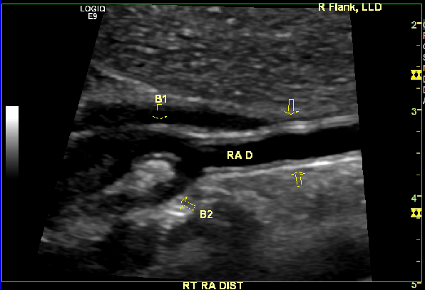
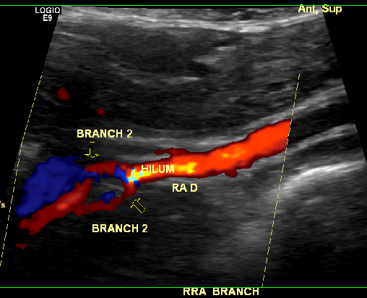
Ling Drost (MRN 5603702) Renal branch w/ FMD

Slide 8
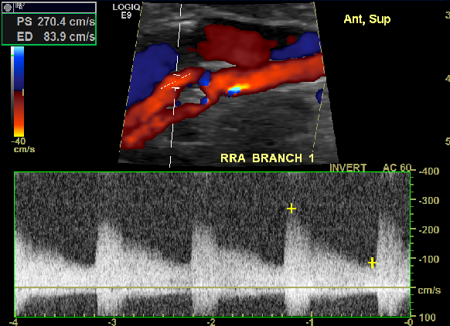
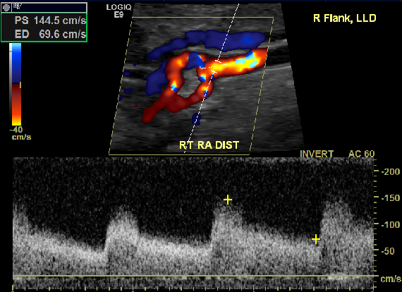
Ling Drost (MRN 5603702) Renal branch w/ FMD

Slide 9
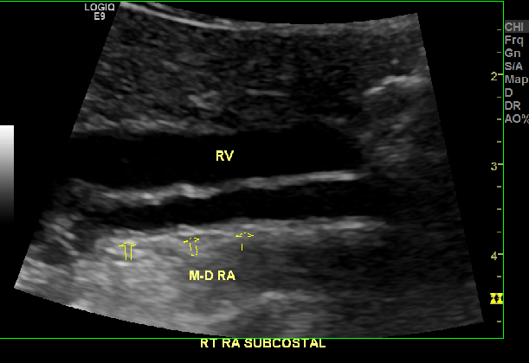
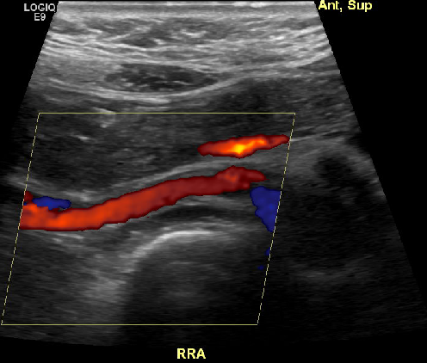
Ling Drost (MRN 5603702) Renal branch w/ FMD

Slide 10
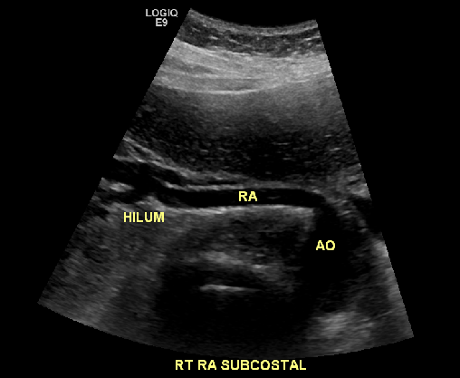
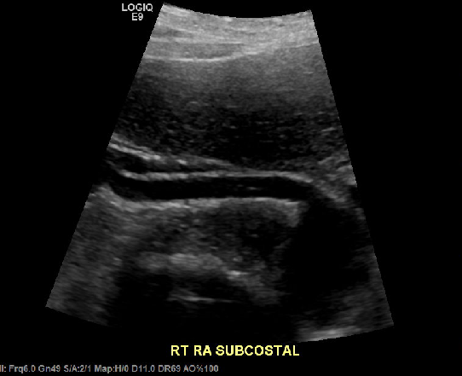
Adair Fields (MRN 5632498) normal RA

Slide 11
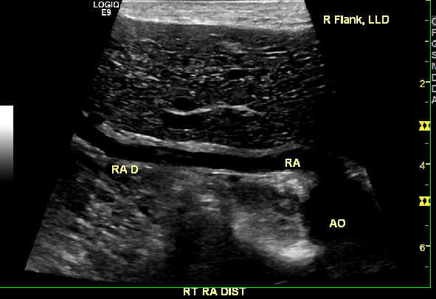
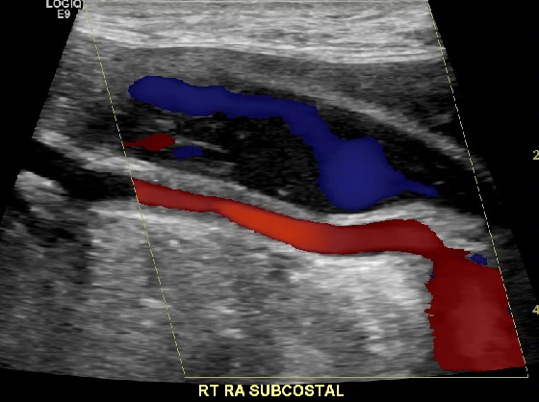
Raynor Maryann (MRN 5607187) RA branch FMD

Slide 12
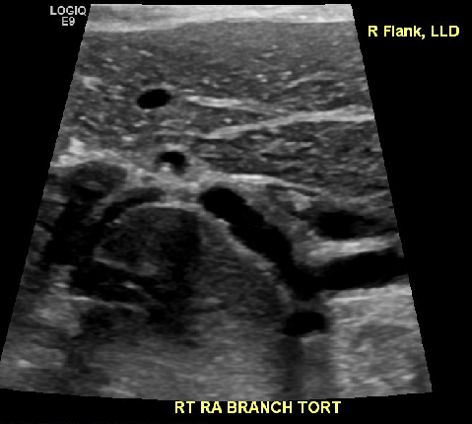
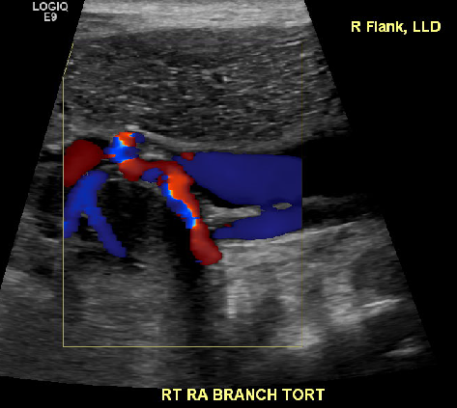
Raynor Maryann (MRN 5607187) RA branch FMD

Slide 13
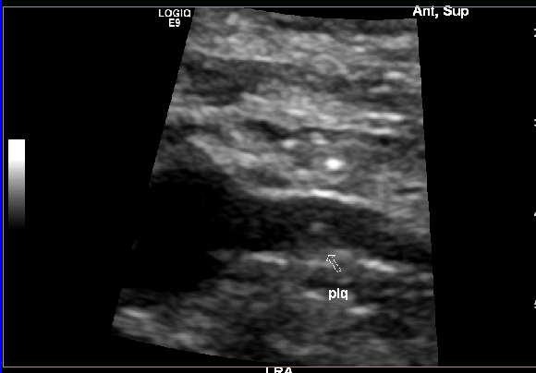
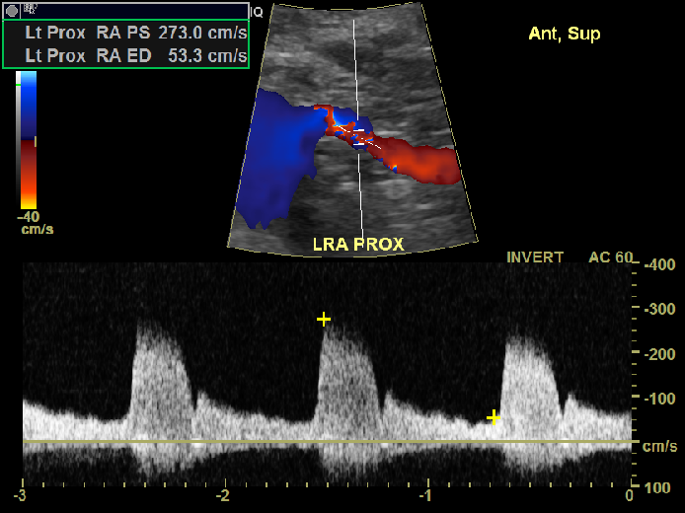
Alfredo Dominguez (MRN 1263606) LRA stenosis.

Slide 14
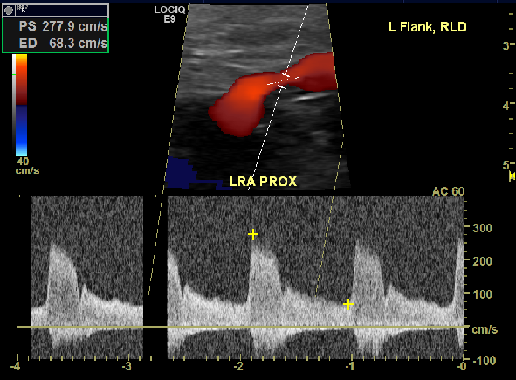
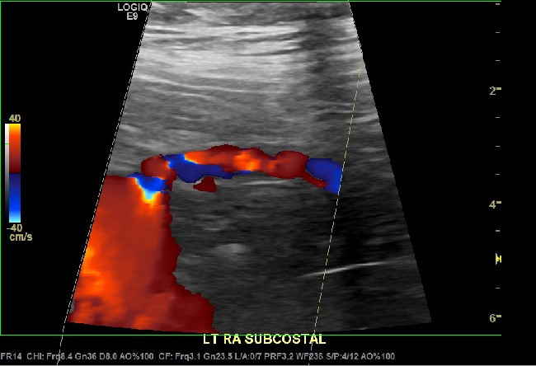
Alfredo Dominguez (MRN 1263606) LRA stenosis.

Slide 15
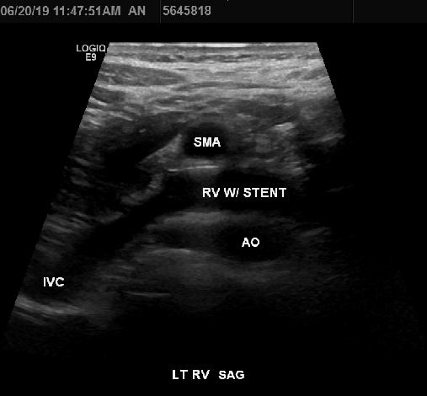
Nutcracker syndrome (corrected via stent)

Slide 16
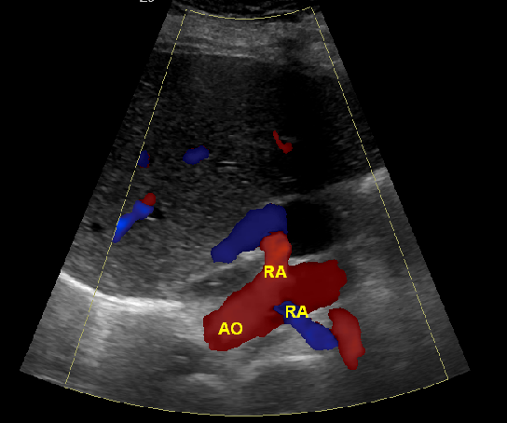
Banana peel

